Slide 1

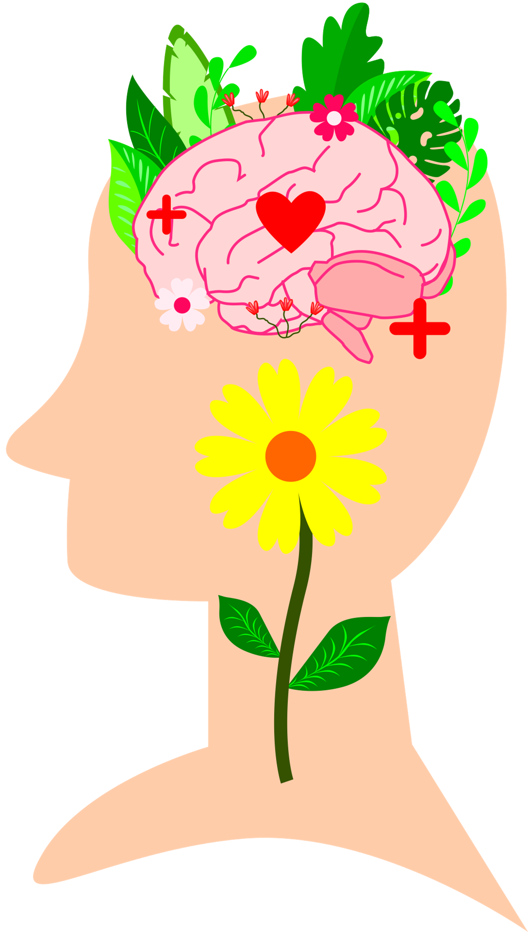

Stress Psychophysiology
Week 2
Remember to Enable Content to view the videos and have the Notes section open to view additional information on the slides
Notes:
Designed and created by Dandi Yang. Do not duplicate or upload with the express written permission of the author.

Slide 2
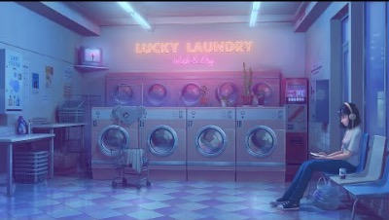
Notes:
Before we begin, please feel free to open up this video, keep in the background and and enjoy some chill, lo-fi beats as you navigate through this lecture. Or watch the video in between work sessions to destress and refocus.

Slide 3

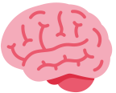
Overview
The Brain
The Endocrine System
Stress Pathways
Stress and Illness
The Stress Response
The Relaxation Response
Notes:
Many people believe stress is strictly psychological and has no impact on physical health- however, it does!
The stress response is a normal adaptive coping response that evolved over hundreds of millions of years to help our ancestors avoid predators. For examples, in the prehistoric time, hunters who encounter a bear may face an increased heart rate and increase breathing to help the individual fight or run from the bear. Unfortunately, our body responds to modern stresses the same as prehistoric ones even though they are not the same type of stressors anymore.

Slide 4
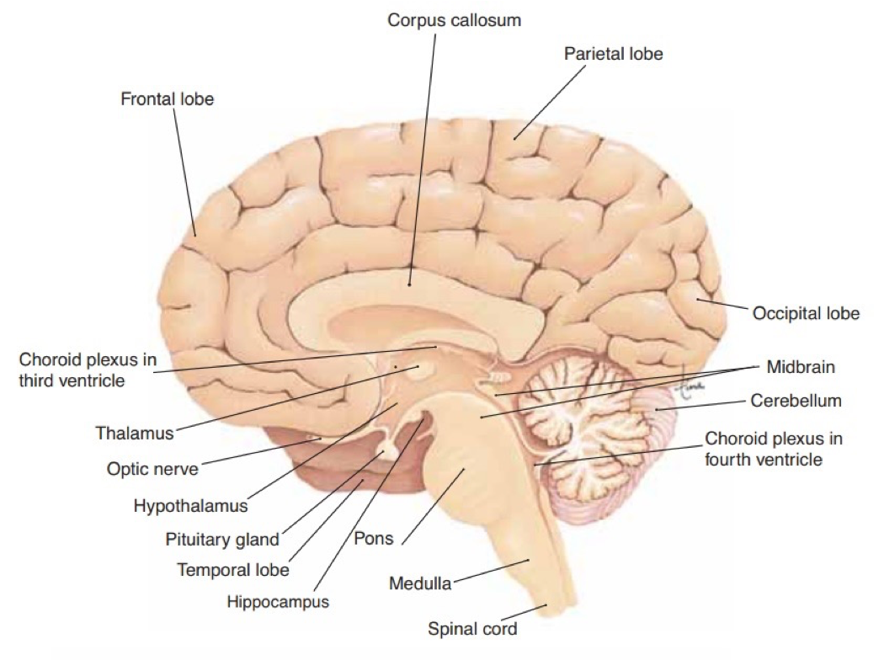
Anatomy of the Brain
Notes:
Just to help you visualize- don't need to memorize it!

Slide 5

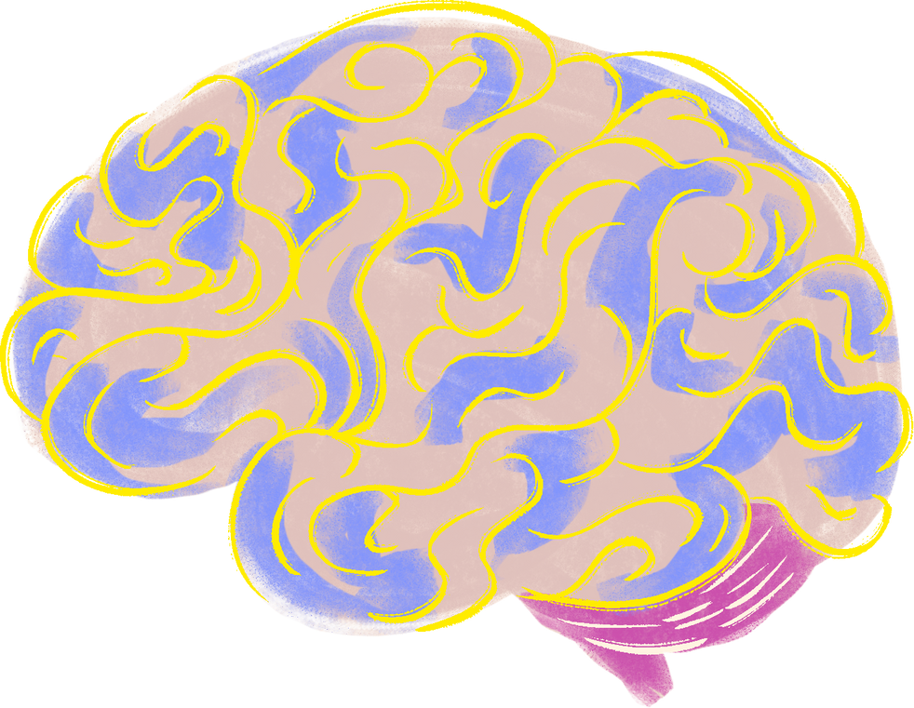
The Brain
Translates the psychological and sociological stressors perceived by the mind
Instructs the rest of the body on how to adjust to the stressors

Slide 6
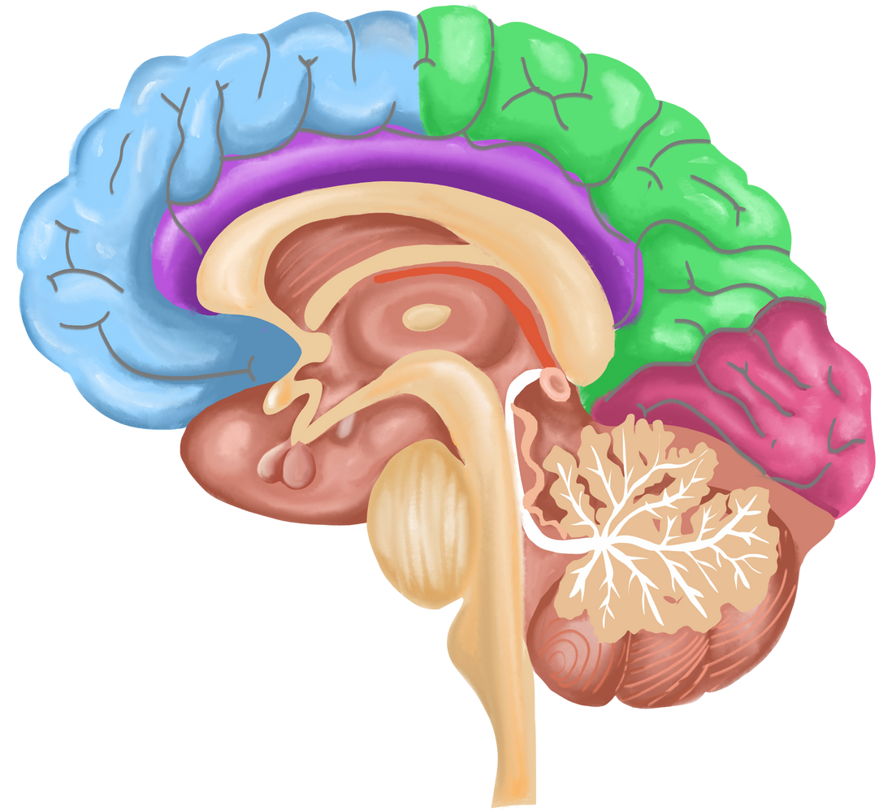
The Brain
Two major components:
Cerebral cortex: the outer layer of the brain, responsible for thinking functions
Memory, attention, awareness, thought
Subcortex: the lower part of the brain responsible for various physiological processes necessary to stay alive
Emotions, body senses, vital life functions
Notes:
Cerebral cortex - divided into four different lobes, the frontal, parietal, temporal, and occipital.
Responsible for thinking and processing information from the five senses. It is also responsible for higher thought processes including speech and decision making.

Slide 7
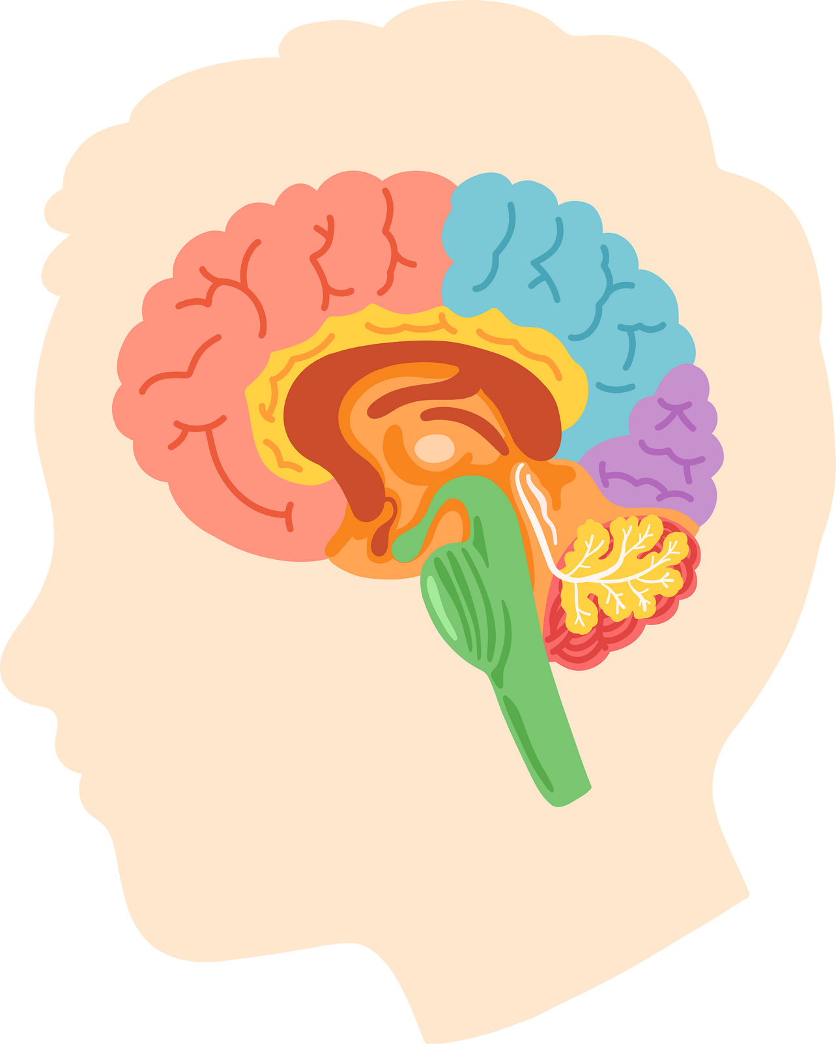

Subcortext
The subcortex includes:
Cerebellum (coordinates body movements)
Medulla oblongata (regulates heartbeat, respiration, other basic processes)
Pons (regulates sleep cycle)
Diencephalon (regulates emotions)
Hypothalamus: activates the autonomic nervous system
Notes:
Subcortex- below the cortex
Our focus will be on the the hypothalamus. It plays a central role in the stress response, as it activates the autonomic nervous system and the endocrine system.

Slide 8
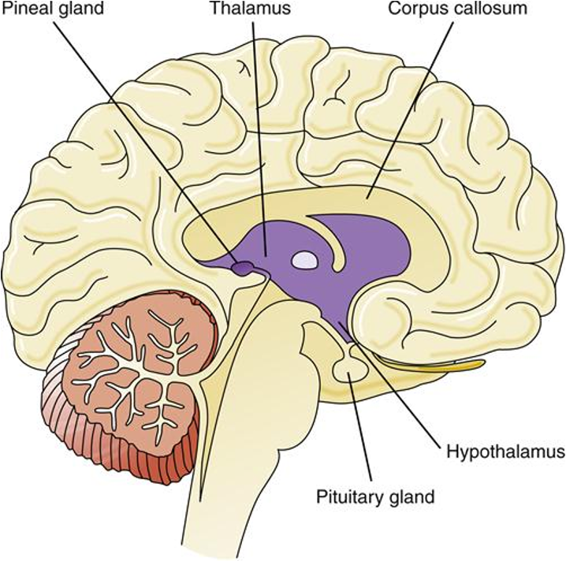
Hypothalamus
Primary activator of the autonomic nervous system, which controls basic body processes such as hormone balance, temperature, and the constriction/dilation of blood vessels
Also activates the endocrine system, which is comprised of hormones that regulate physiological functions
Notes:
The hypothalamus is a kind of control center for emotion and many basic motives. It affects behaviors as diverse as sex, rage, temperature control, hormone release, eating and drinking, sleep, waking, and emotion. The hypothalamus is a sort of "crossroads" that connects with many other areas of the cortex and subcortex. As such, it acts as a "final path" for many kinds of behavior leaving the brain. You might think of the hypothalamus as the last area of the brain where many behaviors are organized or "decided on.”

Slide 9
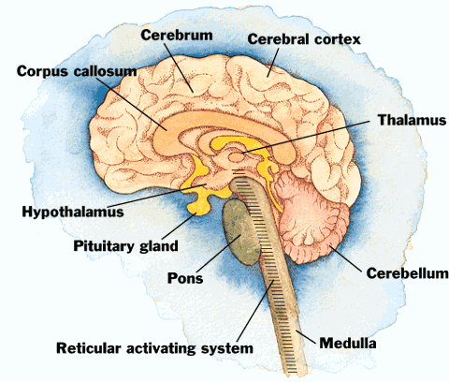
Reticular Activating System
Network of nerves that connects the mind (cerebral cortex) and the body (sub-cortex)
Excessive arousal of the cortex caused by the RAS results in stressful responses
An underaroused cortex results in difficulty in learning, poor memory, and little self-control
Notes:
A complex collection of neurons serving as a point of convergence for signals from the outside world and the internal environment. It is the part of the brain where the world outside, and thoughts and feelings from inside, meet.

Slide 10
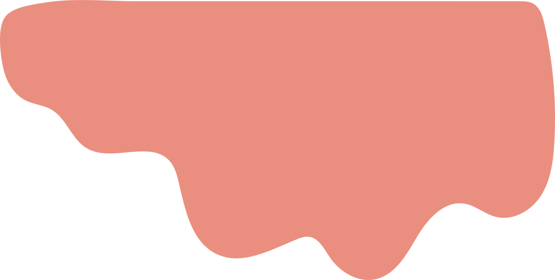
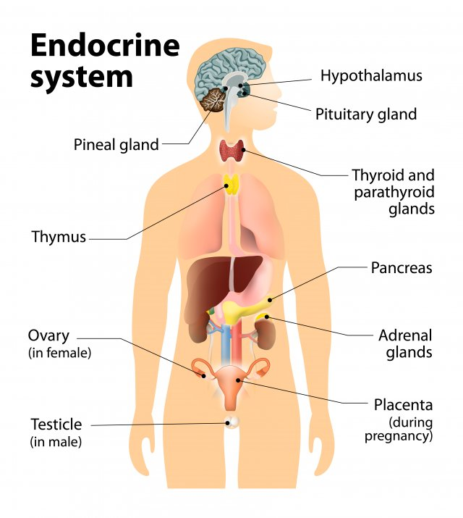
The Endocrine System
Responsible for the release of hormones in the body, including stress hormones.
Four pathways which release hormones responsible for different responses:
Adrenal cortex - secretes cortisol, provides energy for action, increases blood pressure
Adrenal medulla - secretes epinephrine (adrenaline) & norepinephrine, increases heart rate, dilation of arteries & bronchial tubes, constriction of blood vessels in arms & legs
Thyroid gland - increases rate of respiration, heart rate, blood pressure, anxiety, decreases tiredness
Pituitary gland - controls other endocrine glands, and decreases urine production
Notes:
One of the most important systems of the body that is related to stress. Includes all the glands that secrete hormones which alter the function of other bodily tissues and are carried through the circulatory system to various targets.
Upon detecting a threat, the hypothalamus signals the adrenal medulla to secrete two hormones — adrenaline and noradrenaline — into the bloodstream. These increase heart rate and blood pressure. Blood is pumped to extremities and their muscles to help you run or go into battle, while gastrointestinal activity is reduced.
Pituitary Gland: Sometimes called the “master gland,” the pituitary controls most of the other glands in the body, regulating a host of functions including body temperature and urine production (hence those sweaty palms and frequent bathroom trips when you’re nervous). During the stress response, the pituitary produces adrenocorticotropic hormone (ACTH), which prompts the adrenal glands to produce cortisol. Cortisol increases arterial blood pressure, pulling glucose and fat from body tissues into the bloodstream for energy, one reason appetite diminishes during acute stress.
Optional watching: https://www.youtube.com/watch?v=eWHH9je2zG4

Slide 11
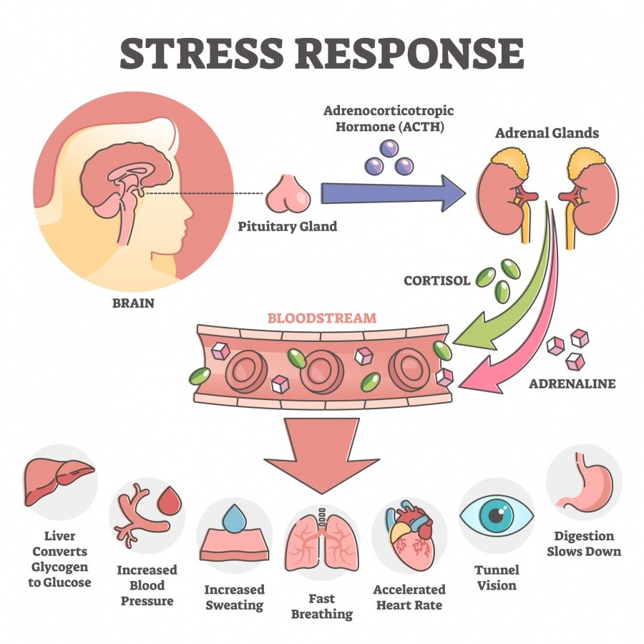

Slide 12
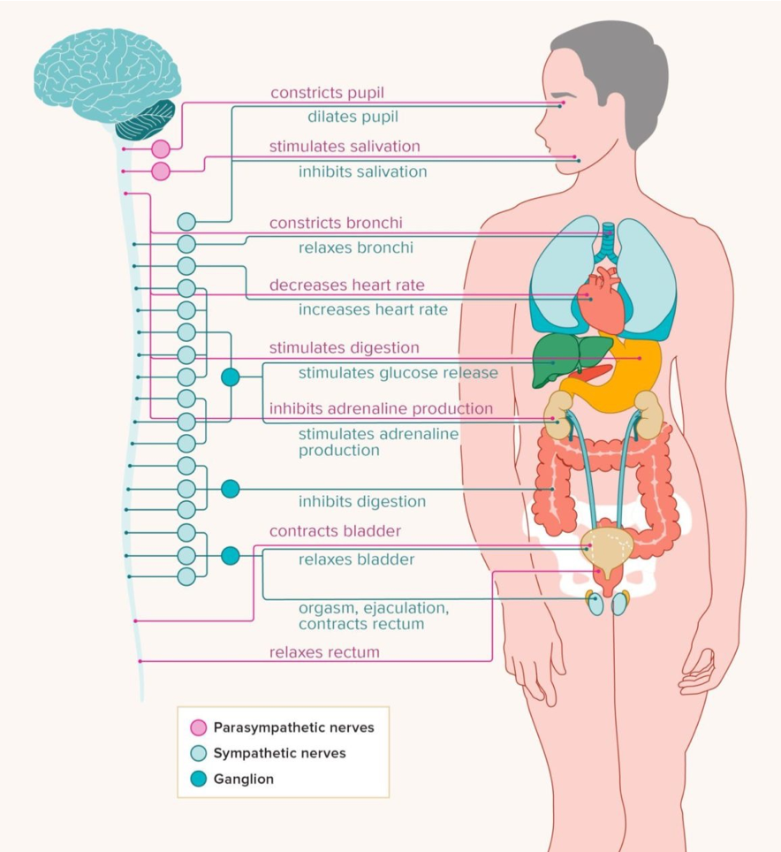

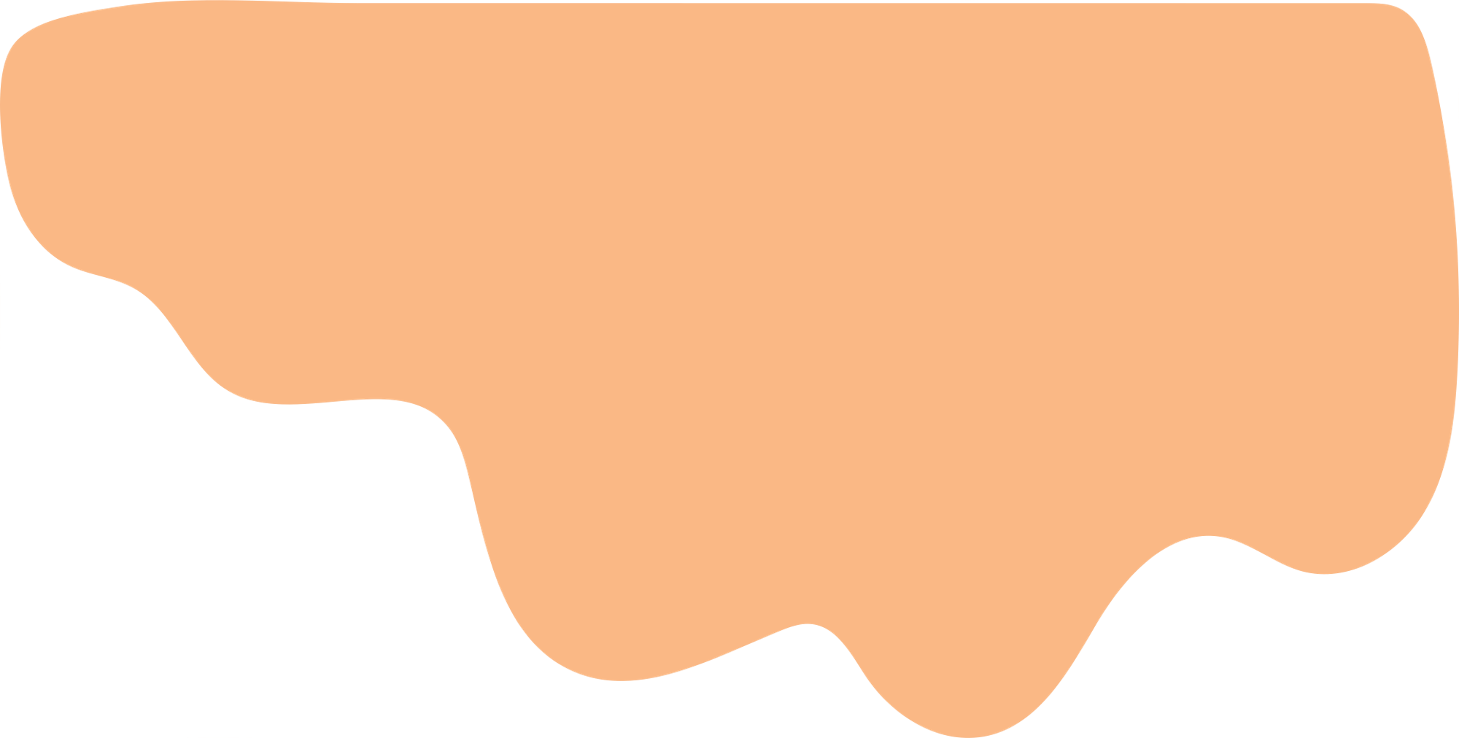
Autonomic Nervous System
Primary system responsible for the fight-or-flight response
Sympathetic nervous system:
Responsible for expending energy
Parasympathetic nervous system:
Responsible for conserving energy
Sympthetic: the fight-or-flight response
Parasympathic: the relaxation response

Slide 13
Sympathic
Nervous System
Parasympathic
Nervous System
1
2
Initiates the fight-or-flight response
Activated whenever there is a thought of potential danger or pain
Increases power, speed, and strength
Returns the body to a state of homeostasis or balance
Restores calm and promotes relaxation
Diverts energy to vital systems during a fight-or-flight response
Notes:
Sympathetic Nervous System:
The body shifts all of its energy resources toward fighting off a life threat, or fleeing from an enemy.
The SNS signals the adrenal glands to release hormones called adrenalin and cortisol. These hormones cause the heart to beat faster, respiration rate to increase, blood vessels in the arms and legs to dilate, digestive process to change and glucose levels (sugar energy) in the bloodstream to increase to deal with the emergency.
When faced with a threat, the heart rate increases, sweating begins, respiration increases, digestion is inhibited, the eyes dilate, and many other things.
Parasympathetic Nervous System
Activates the "rest and digest" or relaxation response, which performs the opposite of all the things listed above (heart rate decreases, digestion activates, salivation increases, etc)
Is a much slower system that moves along longer pathways.
Responsible for controlling homeostasis, or the balance and maintenance of the body’s systems.
It restores the body to a state of calm and counterbalance, and allows it to relax and repair.

Slide 14
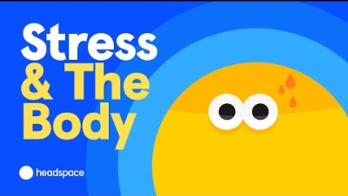
Notes:
https://www.youtube.com/watch?v=a4opDJOCEKA
What physical and mental effects can stress have on our minds and bodies? Dr. Yewande Pearse walks us through the science of stress as we learn about what happens in the brain when someone is stressed, the different kinds of stress, why stress is triggered, and how mindfulness can help.

Slide 15
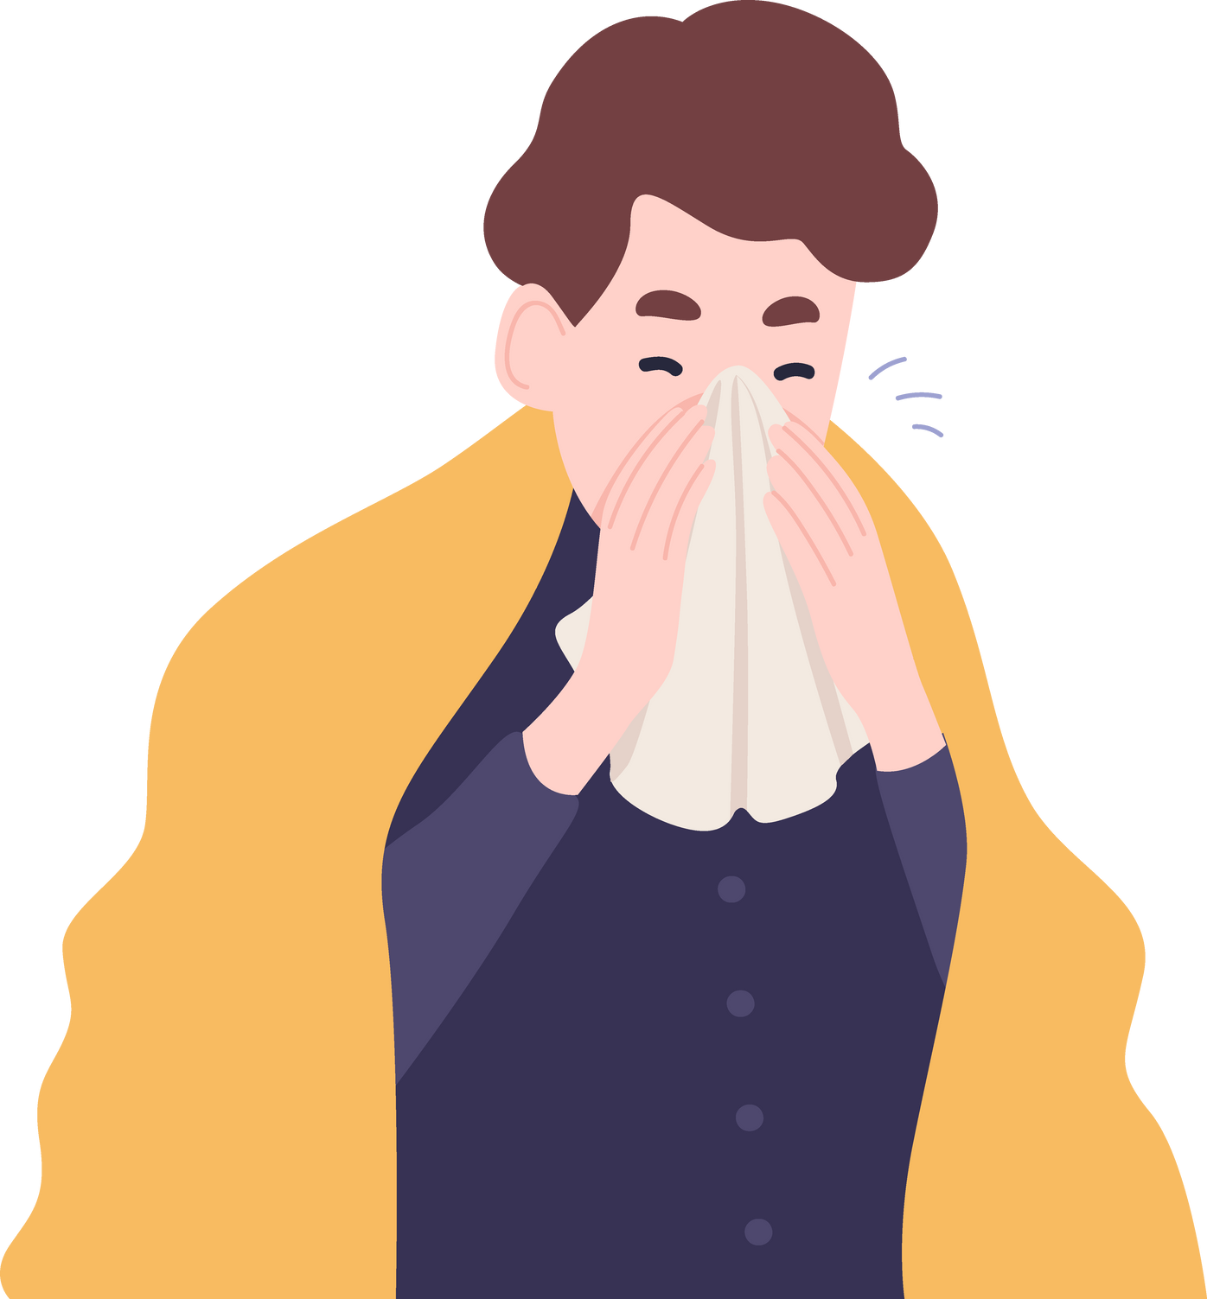
Stress & Illness
Constant stress can have an effect on illness and disease:
Direct effect
Physiological effects on the body
Indirect effect
Changes in your behaviour
Notes:
Physiological effect: Stress lowers white blood cell count
Prolonged stress puts your body in a continuous state readiness for physical action. When your body has no time to re-establish equilibrium, it becomes overworked and your immune system weakens, making you susceptible to sickness. Many essential bodily processes are disrupted and your risk of health problems increases.
Behaviours:
Tiredness, Irritability and Anxiety
Indirect: Loss of appetite or binge eating
Alcohol, smoking

Slide 16
Medium Term Stress
Long Term Chronic Stress
Some effects include:
Some effects include:
Muscle tensions and pain
Headaches
Fatigue
Upset stomach
Difficulty sleeping
Grinding teeth during sleep
Colds or sore throats
Impacts immune system functioning
Premature aging
Heart disease
Mental health conditions
Diabetes, obesity
Notes:
Prolonged stress puts your body in a continuous state readiness for physical action. When your body has no time to re-establish equilibrium, it becomes overworked and your immune system weakens, making you susceptible to sickness. Many essential bodily processes are disrupted and your risk of health problems increases.
How does stress cause premature aging?
Chronic stress accelerates it by eating away at these proteins that protect genetic information as cells divide so they diminish faster than they would naturally.

Slide 17
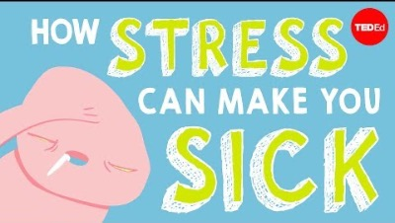
Notes:
Our hard-wired stress response is designed to gives us the quick burst of heightened alertness and energy needed to perform our best. But stress isn’t all good. When activated too long or too often, stress can damage virtually every part of our body. This is what goes on inside our body when we are chronically stressed.
https://www.youtube.com/embed/v-t1Z5-oPtU?feature=oembed

Slide 18
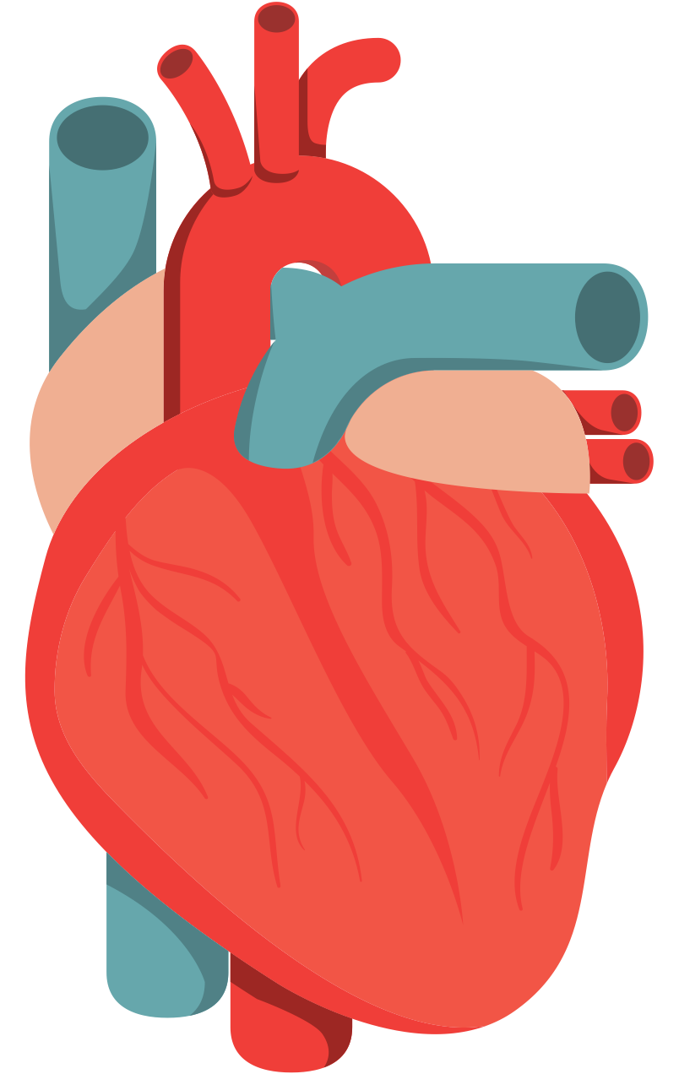
Stress and the Cardiovascular System
Transports blood to cells and organs
Stress on the circulatory system may cause release of oxytocin and vasopressin
Both can constrict blood vessels, leading to increased blood pressure (hypertension)
Heart responds with increased force of contraction
Stress increases cholesterol which also increase risk of heart disease, and strokes
Notes:
Stress and higher cholesterol
Exact reasons are not fully understood. One possible explanation is that stressful situations cause the body to attempt to produce more energy (fatty acids and glucose), requiring increased production of LDL ("bad" cholesterol) by the liver.
Another significant factor is that stress tends to increase unhealthy behaviors and lifestyle choices, including eating an unhealthy diet, smoking, and inactivity

Slide 19
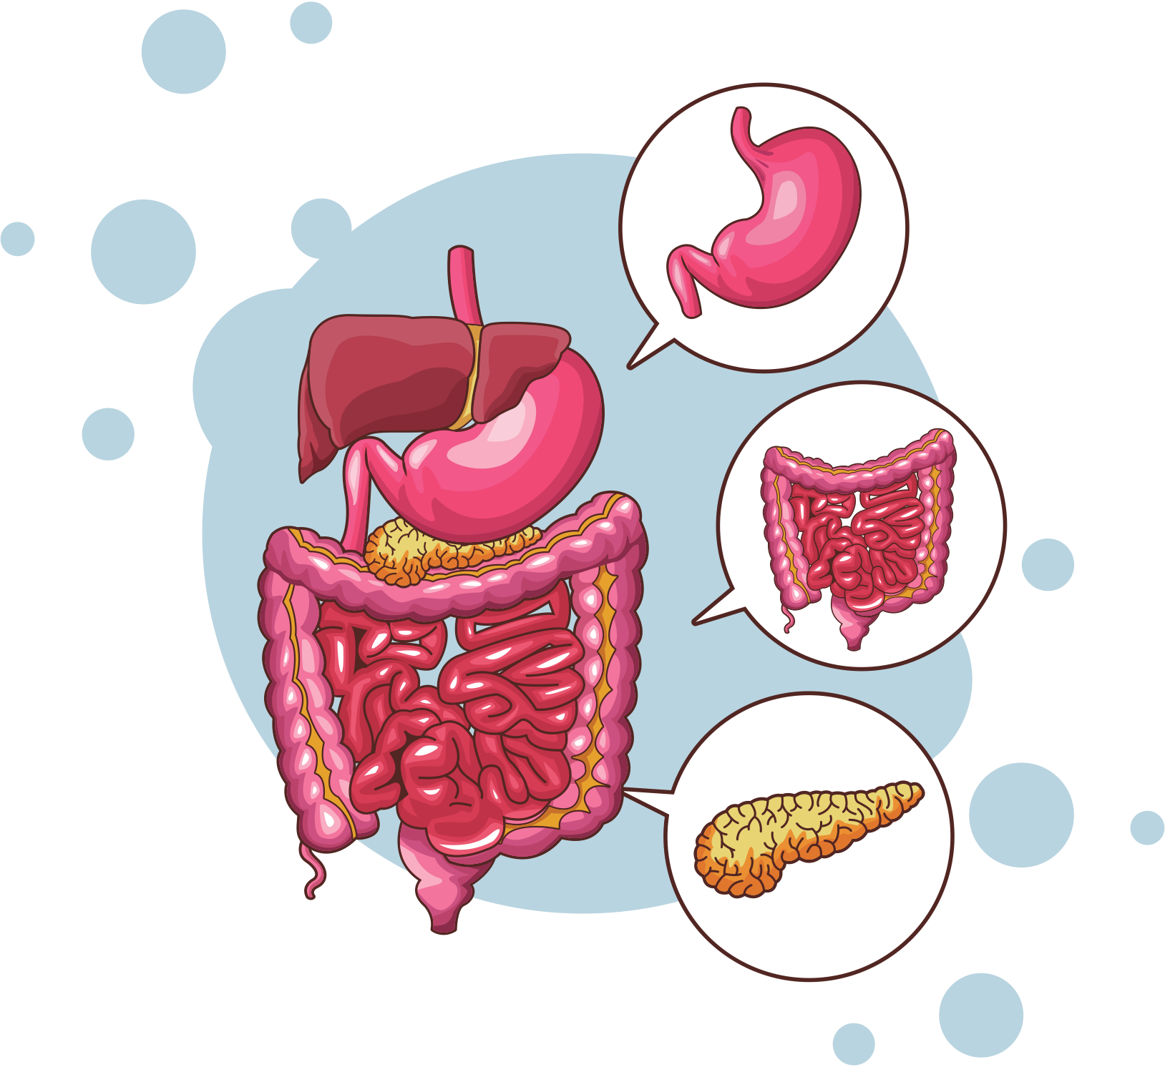
Stress and the Gastrointestinal System
Responsible for digestion
Stress reduces saliva production and can prompt either overproduction or underproduction of digestive acids
Stress can alter peristalsis, the rhythmic movement of food, leading to bowel distress and diseases
Notes:
The slowdown of the digestive process triggered by the sympathetic nervous system and the thyroid can prompt either overproduction or underproduction of digestive acids. Overproduction can lead to painful acid reflux (heartburn), while underproduction means your stomach has limited digestive power. Too little stomach acid can leave food in the system so long that it ferments rather than digests. This can produce bloating, create inflammation of the intestinal tissue and reduce the overall absorption of nutrients.

Slide 20

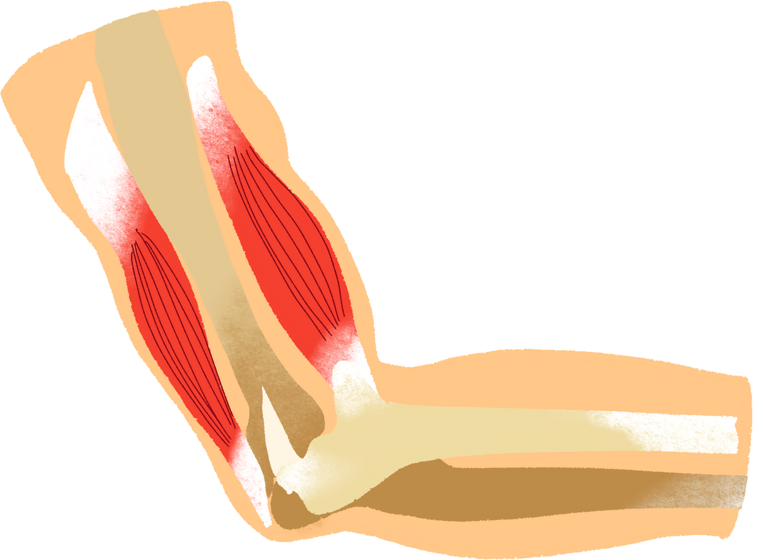
Stress and the Muscles
Stress results in tensing, known as bracing
Bracing leads to the:
Development of muscle pain and aches
Contraction of smooth muscles that control the contraction of internal organs
Smooth muscles controlling the contraction of internal organs can be affected by bracing as well
Notes:
When the body is stressed, muscles tense up. Muscle tension is almost a reflex reaction to stress—the body’s way of guarding against injury and pain.
This constant state of anticipation and readiness brings on chronic bracing-readying yourself for the pain.
Contracting eyes, forehead, neck and jaw leads to headaches.
Back pain, muscle soreness and muscle weakness
Persistent stress in the cardiac muscle leads to the death of cardiac muscle cells and a loss of contractility of the heart.
Stress affects the smooth muscles, such as muscles in your stomach wall- and creating a stomach ache.
Bracing in the smooth muscles of your blood vessels rise in blood pressure
Skeletal muscles- muscles attached to bones.
Musculoskeletal pain in the low back and upper extremities has also been linked to stress, especially job stress.

Slide 21
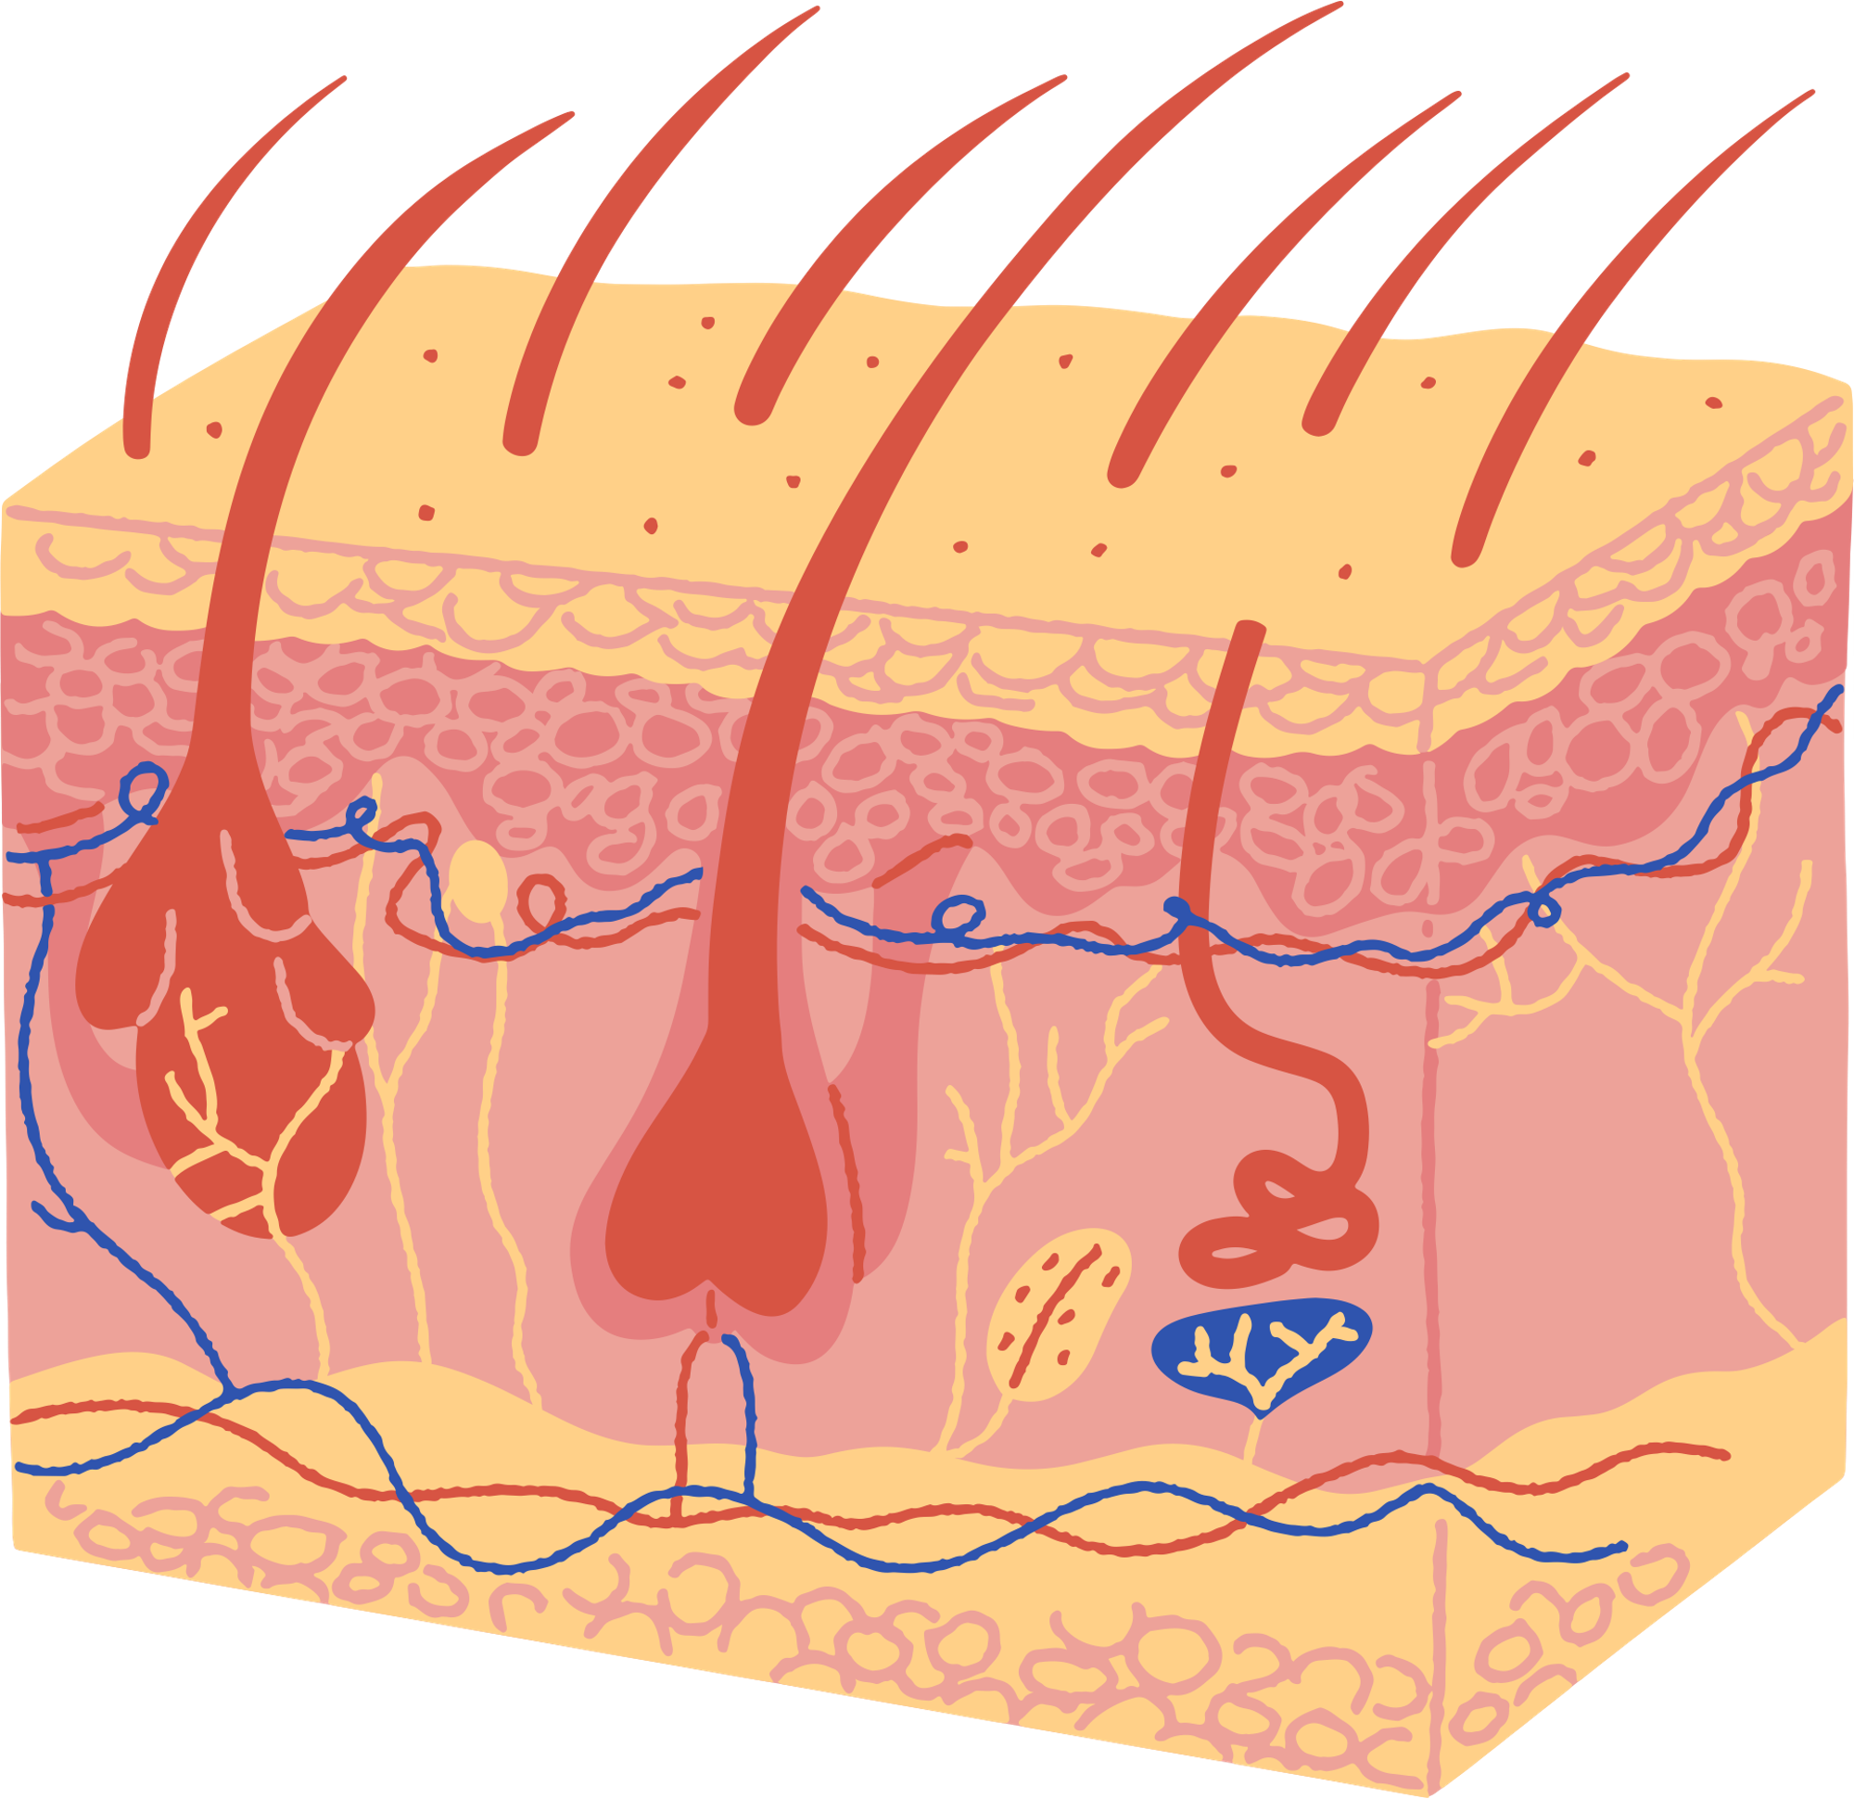
Stress and the Skin
Stress can aggravate many skin conditions like acne, eczema, rashes, itching
Stress may lead to nervous habits that may damage skin
Stress can induce the body to make higher amounts of oil
Stress causes increased perspiration and vasoconstriction
Changes the color of the skin
Notes:
Stress causes a chemical response in your body that makes skin more sensitive and reactive. It can also make it harder for skin problems to heal.
Have you ever noticed that you break out more when you’re stressed? This is because stress causes your body to make hormones like cortisol, which tells glands in your skin to make more oil. Oily skin is more prone to acne and other skin problems.
It can also be stressful to have problems with your skin. Some people feel so bad about how it looks that they keep to themselves, which adds more stress.

Slide 22
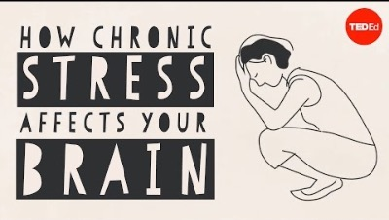
Notes:
https://www.youtube.com/embed/WuyPuH9ojCE?feature=oembed

Slide 23
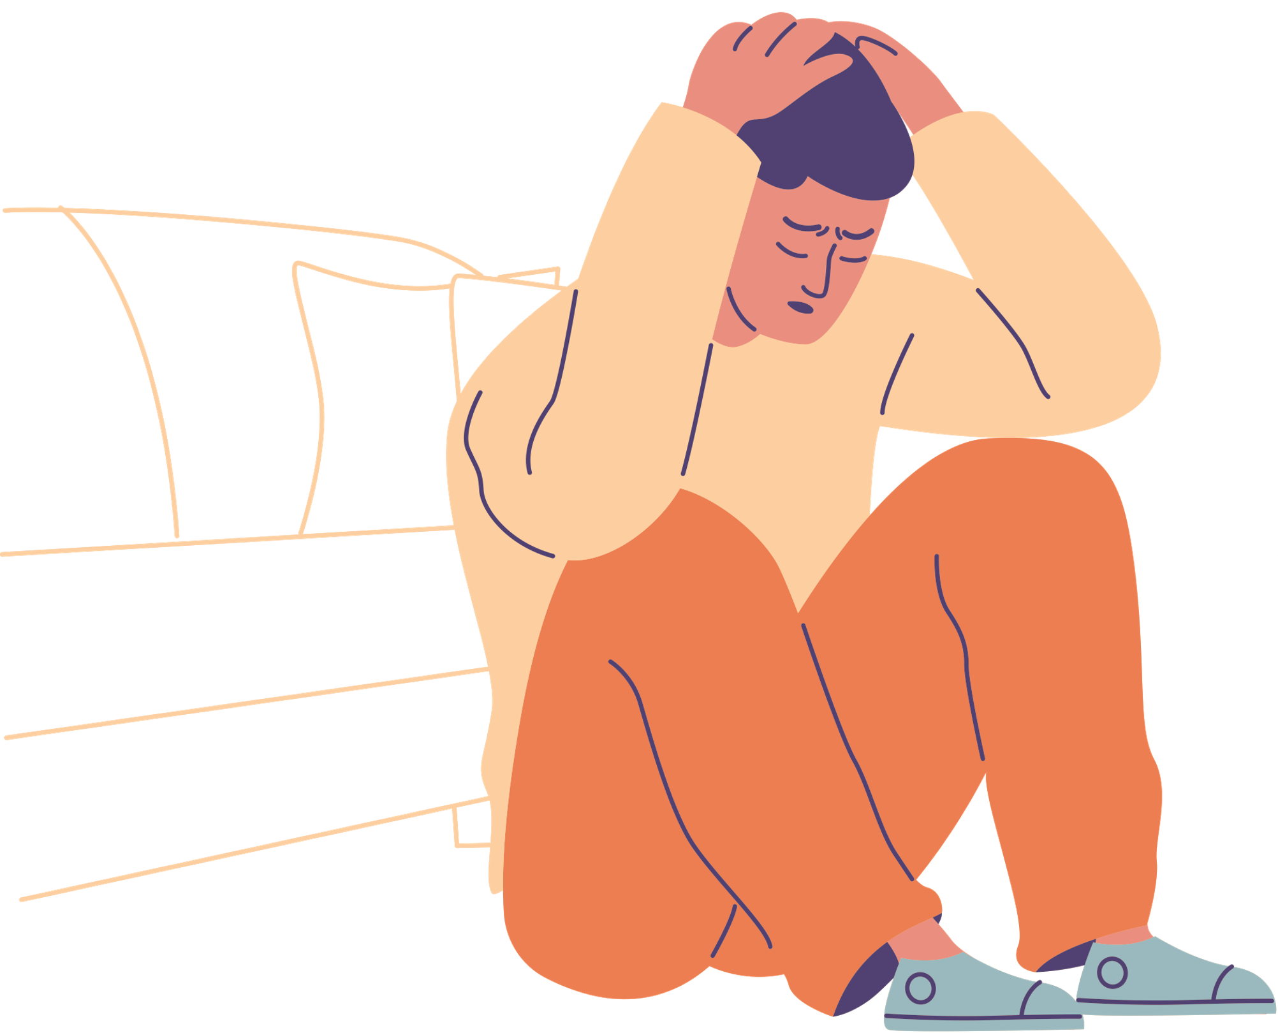
General Adaptation Syndrome
Hans Selye developed the theory that stress affects the body in three phases:
Alarm Stage
Resistance Stage
Exhaustion Stage
Said that stress is a major cause of disease because chronic stress causes long-term chemical changes
Notes:
He observed that the body would respond to any external biological source of stress with a predictable biological pattern in an attempt to restore the body’s internal homeostasis. This initial hormonal reaction is your fight or flight stress response - and its purpose is for handling stress very quickly! The process of the body’s struggle to maintain balance is what Selye termed, the General Adaptation Syndrome.
Pressures, tensions, and other stressors can greatly influence your normal metabolism. Selye determined that there is a limited supply of adaptive energy to deal with stress. That amount declines with continuous exposure.

Slide 24
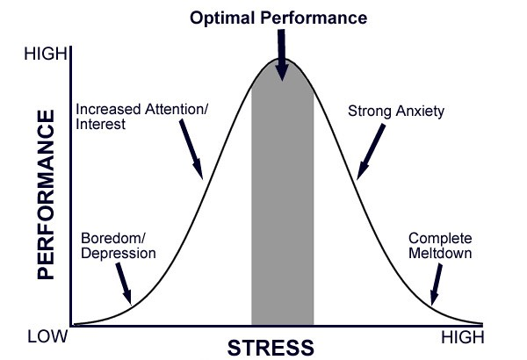
Zones of Stress
Zone of Positive Stress: A range of stress where we are comfortable, productive & healthy
Zone of Overload Distress: Distress caused by too much stress. May include events that require more than we can handle, or stress build-up.
Zone of Underload Distress: Distress caused by too little stress. Can indicate that life events are not challenging enough, or that we are taking too long to recover from a previously stressful event (residual stress) or are anticipating stress all the time and avoiding it. This prevents us from being able to take on new stressors that will challenge, and motivate us to grow.
Notes:
Which zone of stress do you think you’re in right now?

Slide 25
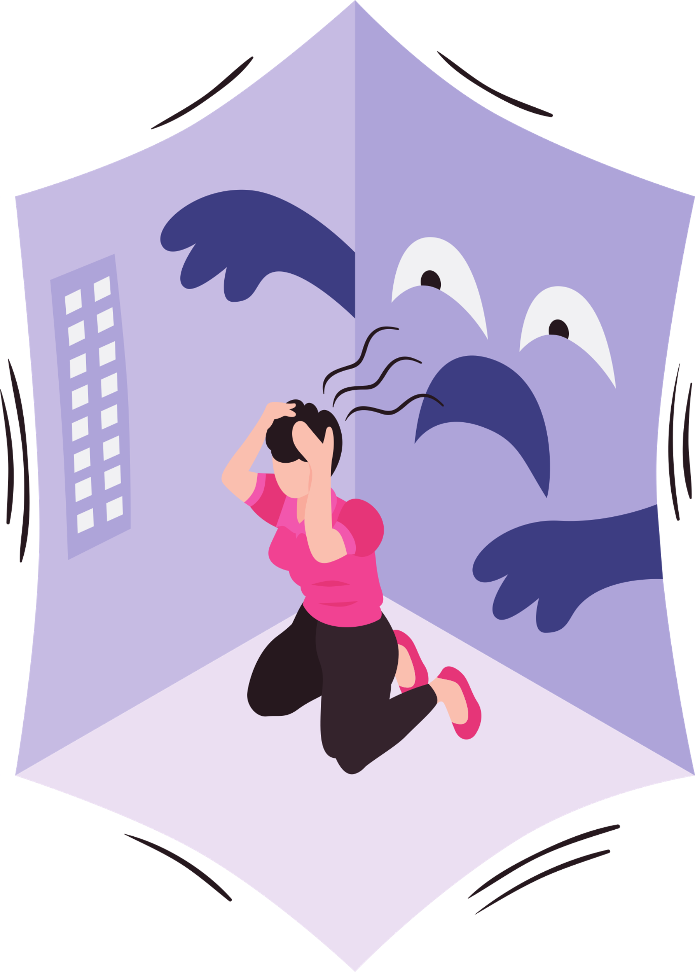
The Stress Response
The fight-or-flight response is inappropriate to today’s social stresses
Many situations other than imminent physical danger can trigger the stress response
Our bodies are unable to distinguish between life-threatening dangers and everyday sources of stress
Notes:
We often feel overloaded with the amount that we want or “need” to do.
Our culture views multitasking as the normal way of getting things done in fact, if we often get praised for it! People who are always busy and have things to do are considered “productive” while those who are doing less are seen as “lazy”. Not true at all!!
It’s important that we take responsibility to slow down as well!

Slide 26

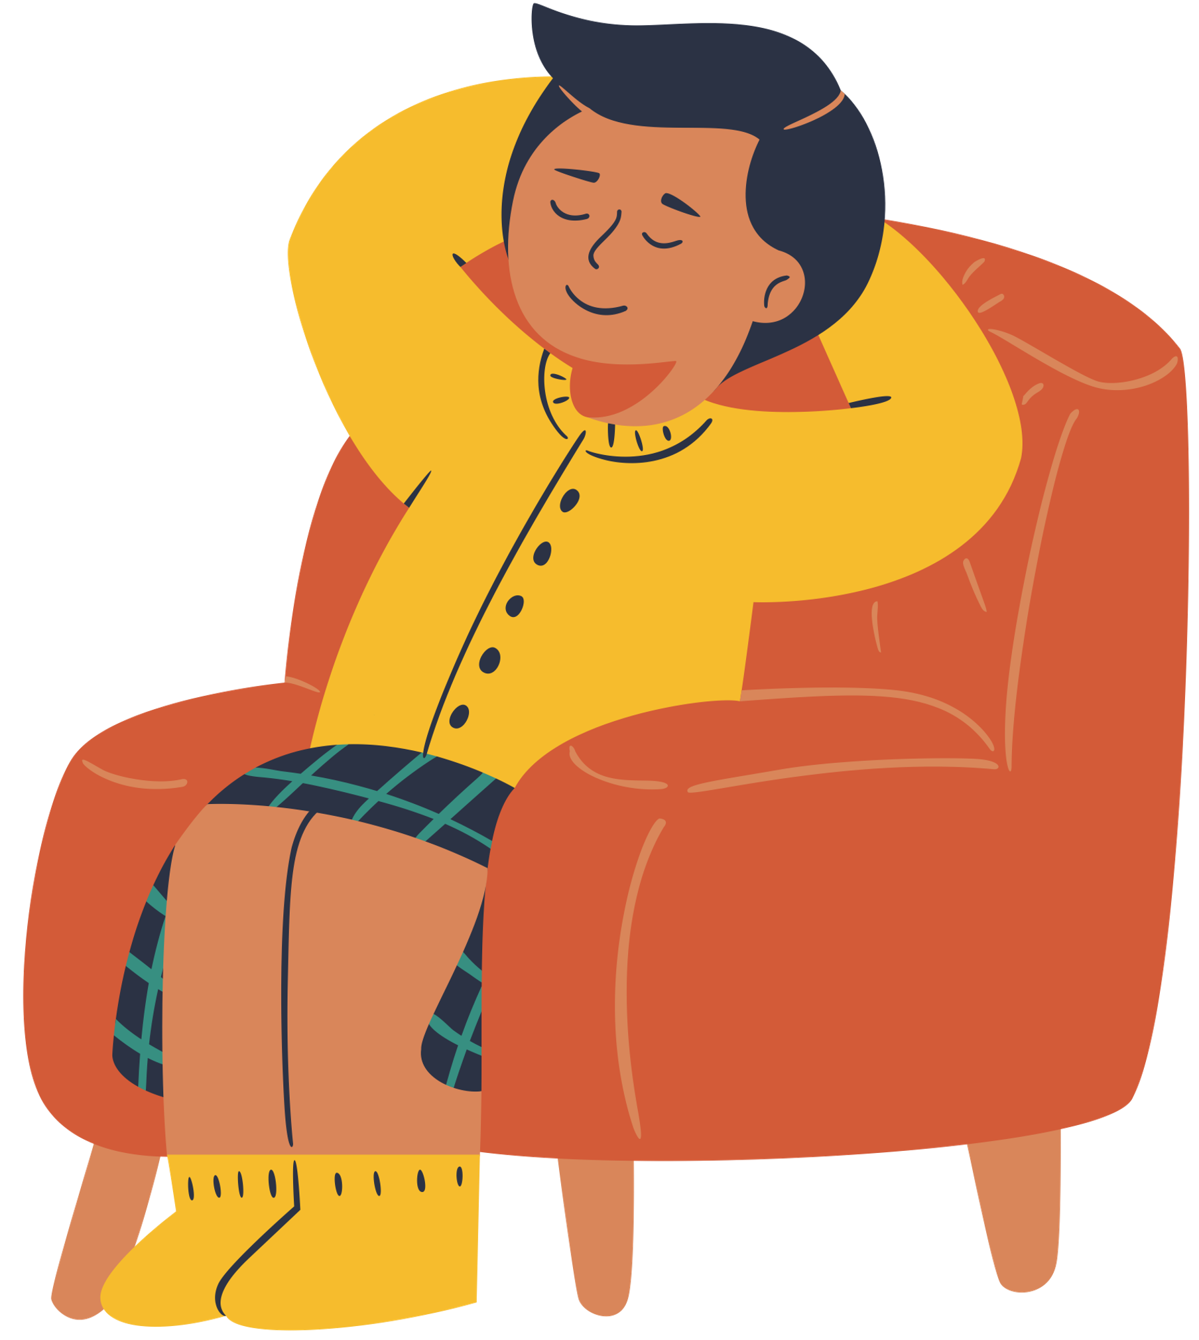
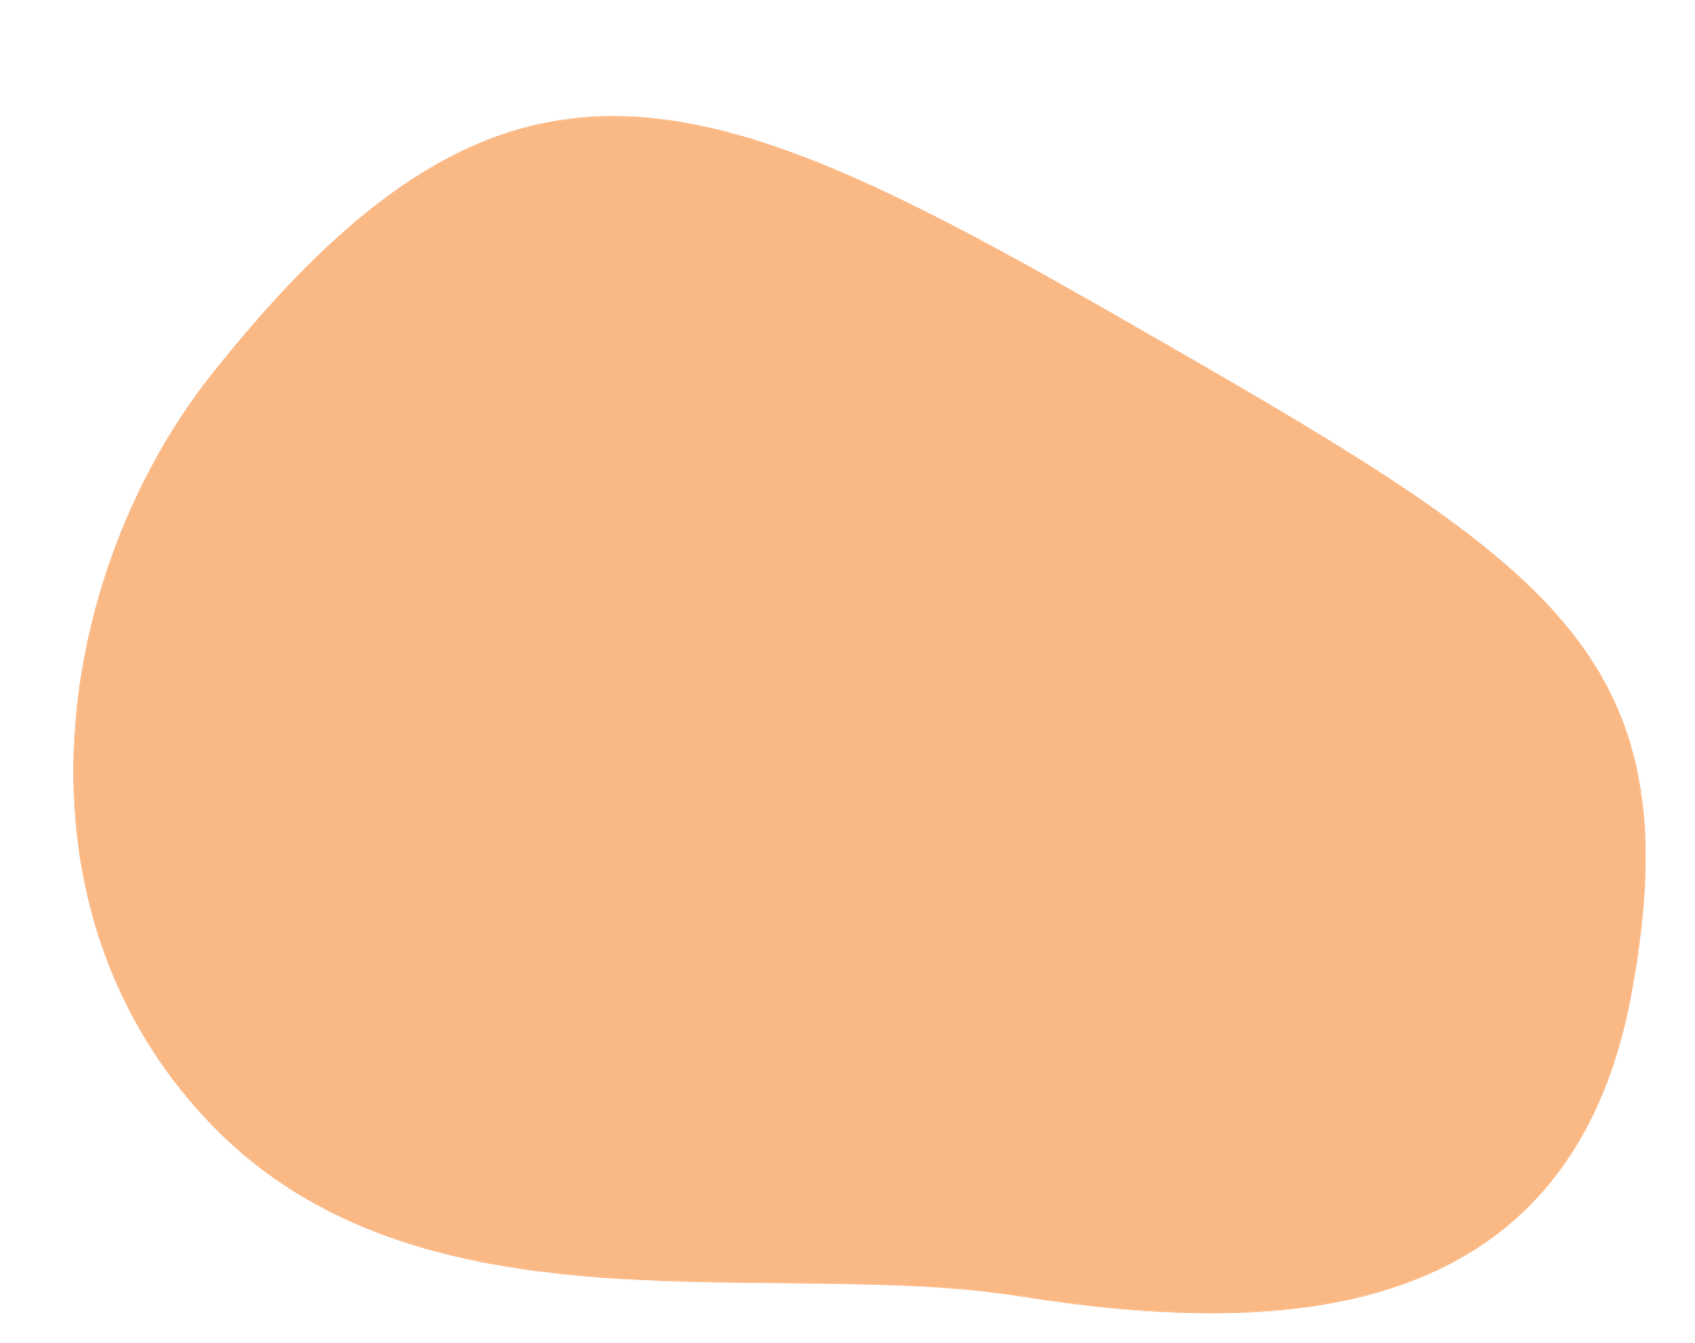
The Relaxation Response
A way to counteract stress
The opposite reaction to the “fight or flight” response
Many methods to elicit the Relaxation Response such visualization, acupuncture, massage, breathing techniques, prayer, meditation, and yoga
We will talk more about this in future lectures

Slide 27

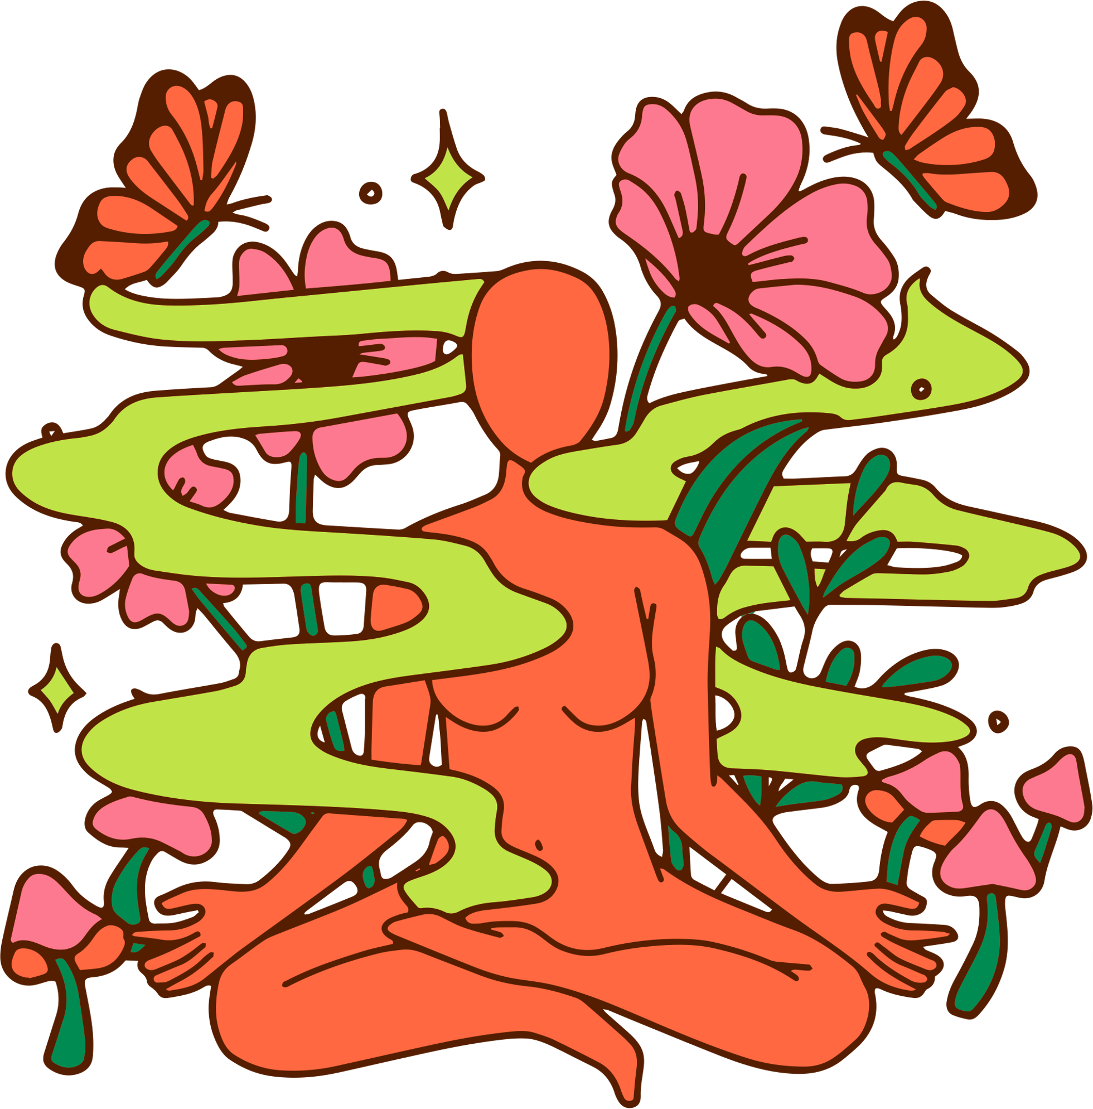
Understanding Stress
When one understands the mechanics of stress, one can see the relationship between the environment, the mind, and the body.
This understanding may lead to the adoption of measures to prevent excess stress.

Slide 28
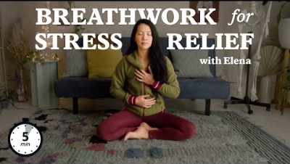
Mindful Moment
Notes:
Follow along with this 5 minute meditation to help re-centre yourself!
https://www.youtube.com/watch?v=K7qP3bxEHwk&t=18s

